Slide 1

Catering Services Database
INFO 5707: Data Modelling for Information Professionals
Team Members Names - Group 12
Naga Moulika Vema (Team Coordinator)
Moulya Reddygari Bhupal
Venkata Naga Triveni Bottu
Tejaswi Gummadi
Sushmitha Gangadari

Slide 2
Contributions of teammates:
Naga Moulika Vema: Data Dictionary, Queries, Documentation
Moulya Reddygari Bhupal: User Requirements, Business Rules and Queries
Venkata Naga Triveni Bottu: Objective, Scope, and Table creation
Tejaswi Gummadi: ERD Diagram and Documentation
Sushmitha Gangadari: Tables creation and Queries

Slide 3
Objective
Catering Services is an event management company within the university, specializing in the food supply chain and organizing various events. To efficiently manage its operations, a comprehensive database is required to track and store information related to events, employees, managers, schedules, and inventory. The current focus of this project is on managing events and scheduling employees for these events.
It manages diverse university events, including daily food supplies to cafés, meetings, gatherings, and sports events, making it impractical to manage all this data through Excel spreadsheets.
The purpose of the database is to provide a user-friendly system that offers clear visibility into employee assignments, event locations, and schedules. The database captures key details such as employee roles (managers, supervisors, full-time, part-time) and allows supervisors to organize events, determine staffing needs, and manage food supplies. Additionally, managers use the system to manage payroll and distribute coupons based on employees' working hours.

Slide 4
Scope
The database will store critical information about the company’s operations, including proprietary data related to events, employee management, food inventory, and payroll.
It will serve as the central hub for organizing and managing:
Employee information (including classifications such as part-time, full-time, supervisors, and non-supervisors)
Event scheduling and employee assignments to events
Food supply management and menu planning
Payroll and coupon distribution for employees based on their hours worked.
The database will ensure that all events held across various university locations are efficiently tracked and managed.

Slide 5
Key Functionalities
Employee Management: Storing detailed employee information, including roles and classifications.
Event Coordination: Planning and tracking events, including the location, and required staff.
Menu and Food Inventory Management: Organizing food supply for events and daily café deliveries.
Event-Employee Mapping: Assigning employees to events based on requirements and availability.
Location Tracking: Managing events across different university venues.
The database is designed as an enterprise-level system, supporting the entire company's operational needs and facilitating the smooth coordination of various tasks across departments.

Slide 6
User Requirements
The system must notify managers first about any new events. Based on the event type, the manager must be able to assign supervisors to oversee the event.
The system must allow managers to select and allocate event locations based on the event’s type and specific requirements.
The system should enable supervisors to assign specific tasks or duties to employees working at the event.
Supervisors must be able to select employees for specific events through the system.
The system must enable managers to allocate work shift-related coupons to employees.
Historical tracking and reporting for analysis of events and employee performance.
Multi-user access (Managers and Supervisors) to ensure concurrent use.
Table/field-level security for sensitive data.
Scalability for future growth in operations.

Slide 7
Business Rules
1. Manager can only add or drop Events
2. Supervisors Can Only Be Assigned by Managers
3. Verification of employee availability is done by supervisor
4. Full-time Employees Must Be Assigned to Priority Events
5. Coupon Distribution is done based on Hours Worked
6. There are few restrictions for event location assignment
7. Supervisors Can Only Manage Employees for Assigned Events
8. Daily Event Limit Per Location is applied
9. Employee Classification and Work Types are done
10. Salary Generation are done based on approved Events

Slide 8
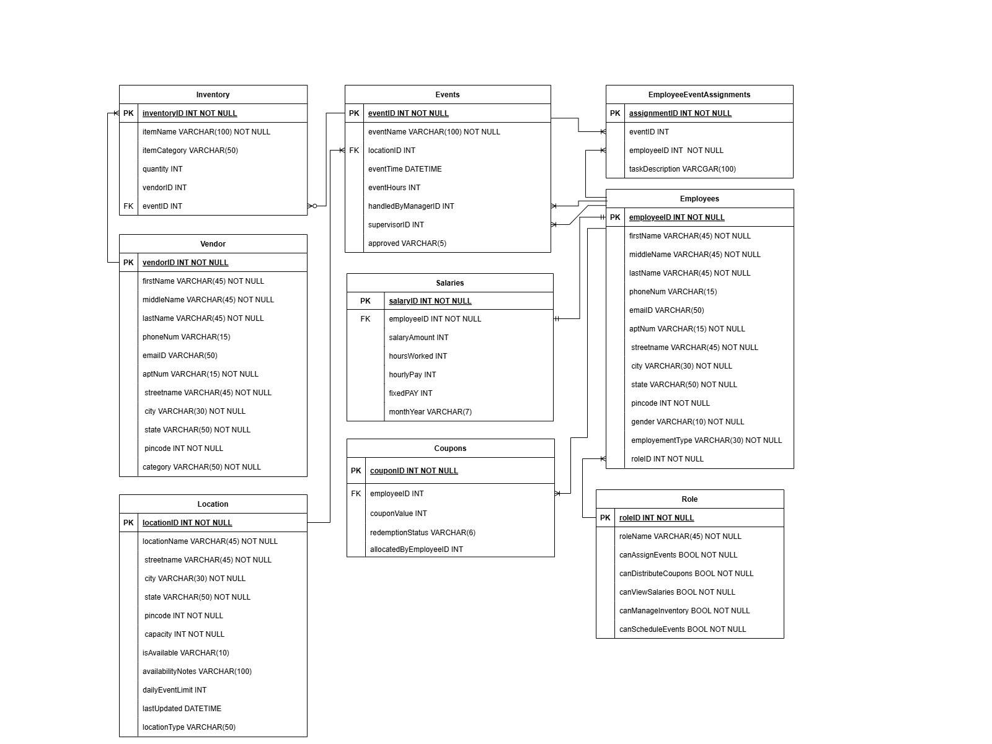
ERD

Slide 9
Data Dictionary – Employee Table
Attribute Name | Contents | Data Type | Format | Range | Required | PK or FK | FK Reference | Sample Data
employeeID | Unique identifier for the employee | INT | N/A | N/A | Y | PK | N/A | 2001
emailID | Employee's email address | VARCHAR(50) | Xxxxx@xxxx.xx | N/A | Y | N/A | N/A | john.doe@univ.com
firstName | Employee's first name | VARCHAR(45) | Xxxxxxxxxxx | N/A | Y | N/A | N/A | John
middleName | Employee's middle name | VARCHAR(45) | Xxxxxxxxxxx | N/A | N | N/A | N/A | David
lastName | Employee's last name | VARCHAR(45) | Xxxxxxxxxxx | N/A | Y | N/A | N/A | Doe
phoneNum | Employee's phone number | VARCHAR(15) | Xxxxxxxxxx | N/A | Y | N/A | N/A | 1234567890
aptNum | Employee's apartment number | VARCHAR(15) | Xxxxxxxxxxx | N/A | N | N/A | N/A | 12B
streetName | Employee's street name | VARCHAR(45) | Xxxxxxxxxxx | N/A | Y | N/A | N/A | Main Street
city | Employee's city | VARCHAR(30) | Xxxxxxxxxxx | N/A | Y | N/A | N/A | CityA
state | Employee's state | VARCHAR(30) | Xxxxxxxxxxx | N/A | Y | N/A | N/A | StateA
pincode | Postal code of employee's address | INT | Xxxxx | N/A | Y | N/A | N/A | 54321
gender | Employee's gender | VARCHAR(10) | Xxxxxxxx | N/A | Y | N/A | N/A | Male
employmentType | Employment type (Full-Time/Part-Time) | VARCHAR(30) | Xxxxxxxxxxx | N/A | Y | N/A | N/A | Full-Time
roleID | Role of the employee | INT | N/A | N/A | Y | FK | Role(roleID) | 1

Slide 10
Data Dictionary – Role Table
Attribute Name | Contents | Data Type | Format | Range | Required | PK or FK | FK Reference | Sample Data
roleID | Unique identifier for the role | INT | N/A | N/A | Y | PK | N/A | 1
roleName | Name of the role | VARCHAR(45) | Xxxxxxxxxxx | N/A | Y | N/A | N/A | Manager
canAssignEvents | Can assign events | BOOLEAN | TRUE/FALSE | N/A | Y | N/A | N/A | TRUE
canDistributeCoupons | Can distribute coupons | BOOLEAN | TRUE/FALSE | N/A | Y | N/A | N/A | TRUE
canViewSalaries | Can view salaries | BOOLEAN | TRUE/FALSE | N/A | Y | N/A | N/A | TRUE
canManageInventory | Can manage inventory | BOOLEAN | TRUE/FALSE | N/A | Y | N/A | N/A | TRUE
canScheduleEvents | Can schedule events | BOOLEAN | TRUE/FALSE | N/A | Y | N/A | N/A | TRUE

Slide 11
Data Dictionary – Events Table
Attribute Name | Contents | Data Type | Format | Range | Required | PK or FK | FK Reference | Sample Data
eventID | Unique identifier for the event | INT | N/A | N/A | Y | PK | N/A | 101
eventName | Name of the event | VARCHAR(100) | Xxxxxxxxxxx | N/A | Y | N/A | N/A | Annual Gala
locationID | Location of the event | INT | N/A | N/A | Y | FK | Location(locationID) | 1
eventTime | Date and time of the event | DATETIME | YYYY-MM-DD HH:MM | N/A | Y | N/A | N/A | 2024-12-01 18:00
eventHours | Total time of the event in hours | INT | N/A | 0 - 8 | Y | N/A | N/A | 5
handledByManagerID | Manager handling the event | INT | N/A | N/A | N | FK | Employee(employeeID) | 1
supervisorID | Supervisor of the event | INT | N/A | N/A | N | FK | Employee(employeeID) | 2
approved | Approval status of the event | VARCHAR(10) | Yes/No | N/A | Y | N/A | N/A | Yes

Slide 12
Data Dictionary – Location Table
Attribute Name | Contents | Data Type | Format | Range | Required | PK or FK | FK Reference | Sample Data
locationID | Unique identifier for the location | INT | N/A | N/A | Y | PK | N/A | 1
locationName | Name of the location | VARCHAR(45) | Xxxxxxxxxxx | N/A | Y | N/A | N/A | Main Hall
streetName | Street name of the location | VARCHAR(45) | Xxxxxxxxxxx | N/A | Y | N/A | N/A | First Ave
city | City where the location is situated | VARCHAR(30) | Xxxxxxxxxxx | N/A | Y | N/A | N/A | CityA
state | State where the location is situated | VARCHAR(30) | Xxxxxxxxxxx | N/A | Y | N/A | N/A | StateA
pincode | Postal code of the location | INT | Xxxxx | N/A | Y | N/A | N/A | 12345
capacity | Capacity of the location | INT | N/A | N/A | Y | N/A | N/A | 500
isAvailable | Availability status | VARCHAR(10) | TRUE/FALSE | N/A | Y | N/A | N/A | TRUE
availabilityNotes | Notes regarding availability | VARCHAR(100) | Xxxxxxxxxxx | N/A | N | N/A | N/A | Available for all events

Slide 13
Data Dictionary – Coupons Table
Attribute Name | Contents | Data Type | Format | Range | Required | PK or FK | FK Reference | Sample Data
couponID | Unique identifier for the coupon | INT | N/A | N/A | Y | PK | N/A | 301
employeeID | Employee receiving the coupon | INT | N/A | N/A | Y | FK | Employee(employeeID) | 2001
couponValue | Value of the coupon | INT | N/A | N/A | Y | N/A | N/A | 5
redemptionStatus | Status of coupon (Redeemed/Unredeemed) | VARCHAR(10) | Xxxxxxxxx | N/A | Y | N/A | N/A | Unredeemed
allocatedByEmployeeID | Employee allocating the coupon | INT | N/A | N/A | Y | FK | Employee(employeeID) | 2002

Slide 14
Data Dictionary – Salaries Table
Attribute Name | Contents | Data Type | Format | Range | Required | PK or FK | FK Reference | Sample Data
employeeID | Employee receiving the salary | INT | N/A | N/A | Y | PK, FK | Employee(employeeID) | 2001
salaryAmount | Total salary of the employee | INT | N/A | 0-99999 | Y | N/A | N/A | 5000
hoursWorked | Number of hours worked (for part-time) | INT | N/A | 0-40 | N | N/A | N/A | 20
hourlyPay | Hourly pay rate for part-time employees | INT | N/A | 0-100 | N | N/A | N/A | 25
fixedPay | Fixed salary for full-time employees | INT | N/A | 0-99999 | N | N/A | N/A | 5000

Slide 15
Data Dictionary – Vendor Table
Attribute Name | Contents | Data Type | Format | Range | Required | PK or FK | FK Reference | Sample Data
vendorID | Unique identifier for the vendor | INT | N/A | N/A | Y | PK | N/A | 501
firstName | Vendor's first name | VARCHAR(45) | Xxxxxxxxxxx | N/A | Y | N/A | N/A | Alice
middleName | Vendor's middle name | VARCHAR(45) | Xxxxxxxxxxx | N/A | N | N/A | N/A | NULL
lastName | Vendor's last name | VARCHAR(45) | Xxxxxxxxxxx | N/A | Y | N/A | N/A | Supplier
phoneNum | Vendor's phone number | VARCHAR(15) | Xxxxxxxxxx | N/A | Y | N/A | N/A | 1234567890
emailID | Vendor's email address | VARCHAR(50) | Xxxxx@xxxx.xx | N/A | Y | N/A | N/A | alice.supplier@xyz.com
aptNum | Vendor's apartment number | VARCHAR(15) | Xxxxxxxxxxx | N/A | N | N/A | N/A | 12A
streetName | Vendor's street name | VARCHAR(45) | Xxxxxxxxxxx | N/A | Y | N/A | N/A | Vendor Lane
city | Vendor's city | VARCHAR(30) | Xxxxxxxxxxx | N/A | Y | N/A | N/A | CityA
state | Vendor's state | VARCHAR(30) | Xxxxxxxxxxx | N/A | Y | N/A | N/A | StateA
pincode | Vendor's postal code | INT | Xxxxx | N/A | Y | N/A | N/A | 54321
category | Type of goods provided by the vendor | VARCHAR(50) | Xxxxxxxxxxx | N/A | Y | N/A | N/A | Food

Slide 16
Data Dictionary – Inventory Table
Attribute Name | Contents | Data Type | Format | Range | Required | PK or FK | FK Reference | Sample Data
inventoryID | Unique identifier for the inventory item | INT | N/A | N/A | Y | PK | N/A | 601
itemName | Name of the inventory item | VARCHAR(100) | Xxxxxxxxxxx | N/A | Y | N/A | N/A | Napkins
itemCategory | Category of the inventory item | VARCHAR(50) | Xxxxxxxxxxx | N/A | Y | N/A | N/A | Supplies
quantity | Quantity of the inventory item | INT | N/A | N/A | Y | N/A | N/A | 1000
vendorID | Vendor supplying the inventory item | INT | N/A | N/A | Y | FK | Vendor(vendorID) | 501
eventID | Event using the inventory item | INT | N/A | N/A | N | FK | Events(eventID) | 101

Slide 17
Data Dictionary – EmployeeEventAssignments Table
Attribute Name | Contents | Data Type | Format | Range | Required | PK or FK | FK Reference | Sample Data
assignmentID | Unique identifier for the assignment | INT | N/A | N/A | Y | PK | N/A | 701
employeeID | Employee assigned to the event | INT | N/A | N/A | Y | FK | Employee(employeeID) | 2001
eventID | Event to which the employee is assigned | INT | N/A | N/A | Y | FK | Events(eventID) | 101
taskDescription | Description of the assigned task | VARCHAR(100) | Xxxxxxxxxxx | N/A | N | N/A | N/A | Setup Venue

Slide 18
5 Queries:
1. Calculate total salary paid by employment type for December 2024.
2. To count the number of events hosted at each location and orders the results by the total number of events in descending order.
3. Top 5 employees who have the highest number of event assignments and lists their first name, last name, and total number of assignments.
4. Total number of coupons issued to each employee and how many of those coupons have been redeemed.
5. First name and last name of employees who are assigned to events taking place at the location with the maximum capacity.

Slide 19
Thankyou!!
Any Queries?

